Slide 1
REFACTORING
TOPIC 10
UTM-SERG Research & Consultancy Team
School of Computing
Faculty of Engineering
Universiti Teknologi Malaysia
UTM, Skudai, Johor.

Slide 2
AGENDA
Agenda 1: Introduction
Agenda 2: Reverse and reengineering
Agenda 3: Refactoring
Agenda 4: Example
Agenda 5: Summary

Slide 3
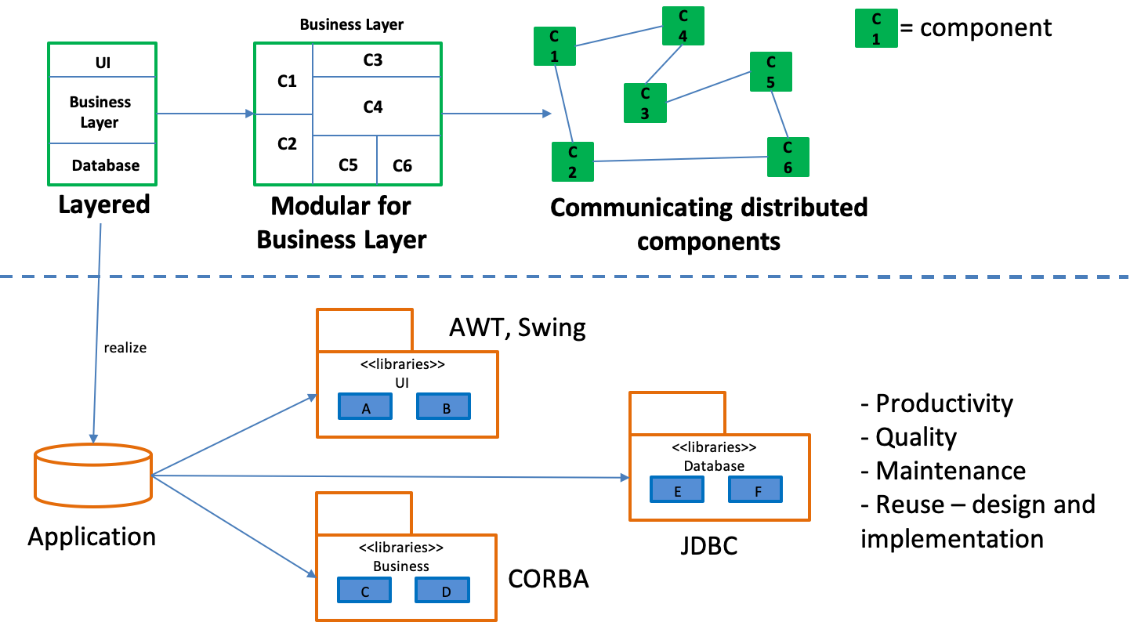
INTRODUCTION
COMPLETE!!
Next stage
Refactoring process

Slide 4
INTRODUCTION
WHAT
WHY
HOW
Reverse: Process of analyzing
existing system
Reengineering: Recreate the
system with different view
Modularization
Performance
Adaptability
Increase Quality
Upgrade
Restructuring
Data engineering

Slide 5
REVERSE AND REENGINEERING

Slide 6
REFACTORING
A process to change a software to improve its internal structure.
Does not alter the external behavior of the code
Clean up a code and minimizing a potential bugs.

Slide 7
REFACTORING
A new requirement for the existing system
Typical approach: copying/duplicating existing class/method
Problems: redundant solution for the design and code
HOW
Rule 1
New function was introduced and existing code does not permit the changes then;
  Change the code and design entirely
Rule 2
Before change, the code/design, the test cases need to create/change as well
Then, checked again whether it will effect another functionality

Slide 8
EXAMPLE
New requirements:
The statement can be generated by plain text and HTML format

Slide 9
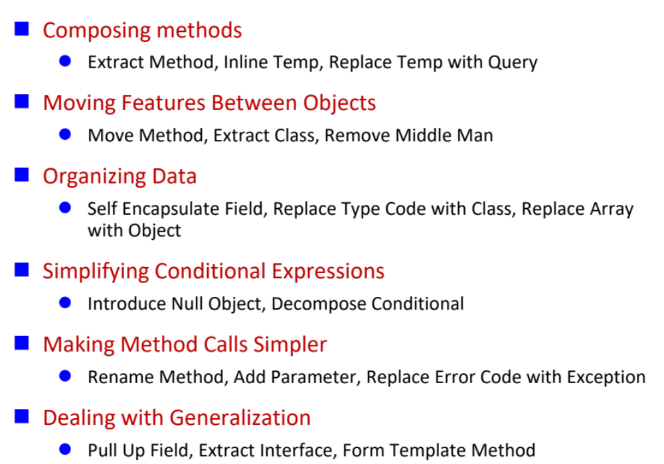
FOWLER’S REFACTORING
Structure
Refactoring categories
Name
Context
Mechanics/steps
Example

Slide 10
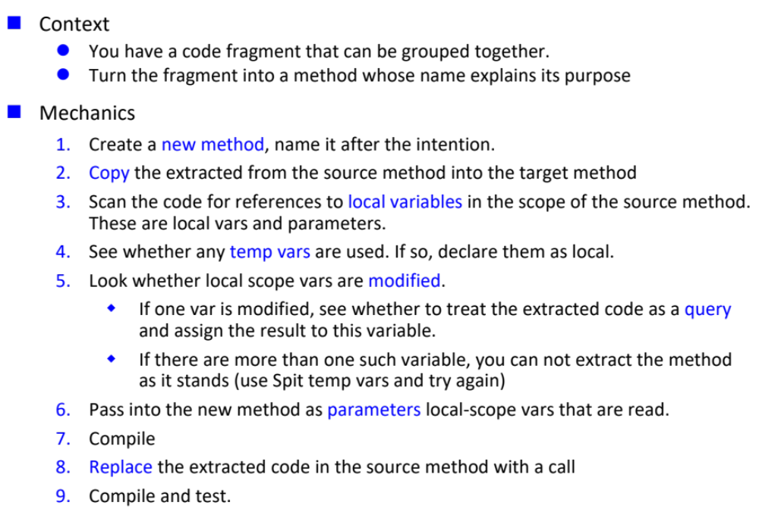
FOWLER’S REFACTORING
Extract Method

Slide 11
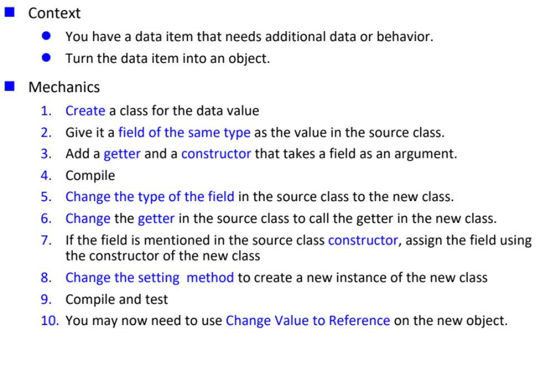
FOWLER’S REFACTORING
Replace data value with object

Slide 12
SUMMARY
Refactoring is process to improve a design in a small manageable steps
Functionality is not allowed to change
Aligned with systematic testing; test cases need to be revised/created as well in a
regression way

Slide 13

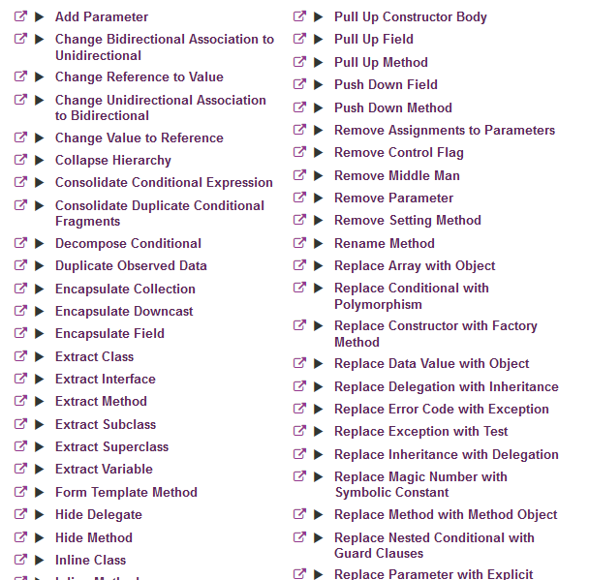
REFACTORING CATALOGUE

